Slide 1
MGMT6059: Project Management Software
Lawrence Kinlin School of BusinesS
Module 7
Notes:
Used when no picture is available.

Slide 2
Agenda
Critical Path Identification
Free Slack, Total Slack
Managing Resource Allocation (e.g., levelling)
Critical Path Analysis
Setting Schedule Baselines

Slide 3
Critical Path Identification and Slack

Slide 4
Critical Path
Series of tasks that dictate the Finish date for the project (the longest path for your project, containing tasks with zero slack)
Visible in the Network Diagram or Gantt chart

Slide 5
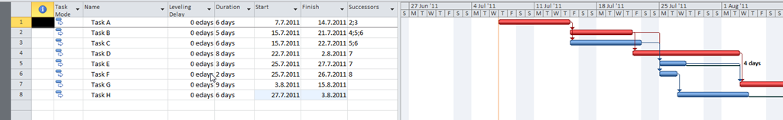
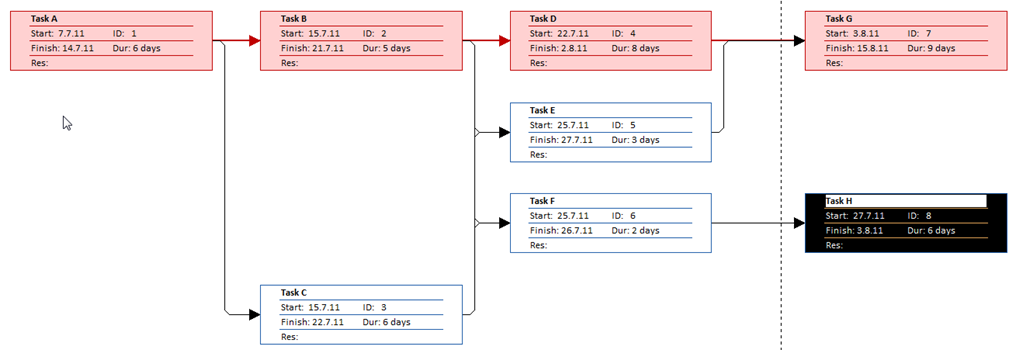
Critical Path (red)
Source: http://ntrajkovski.wordpress.com/2011/07/05/critical-path-in-ms-project-2010part-1/
Notes:
Image Source: Bunin, New Perspectives on Microsoft Project 2010

Slide 6
Free Slack and Total Slack
Free Slack: amount of time that a task can be delayed without delaying successor tasks
Total Slack (Float): amount of time that a task can be delayed from its planned start date without delaying the project Finish date

Slide 7
Critical Path Identification
Showing on the Gantt
Showing on the Network Diagram
Showing on the Calendar
Applying Filters

Slide 8
Overallocation and Resource Leveling

Slide 9
Overallocation
Occurs when a resource is assigned more work in a given time period than it has working hours, or more than 60 minutes in an hour
Levelling corrects overallocation issues

Slide 10
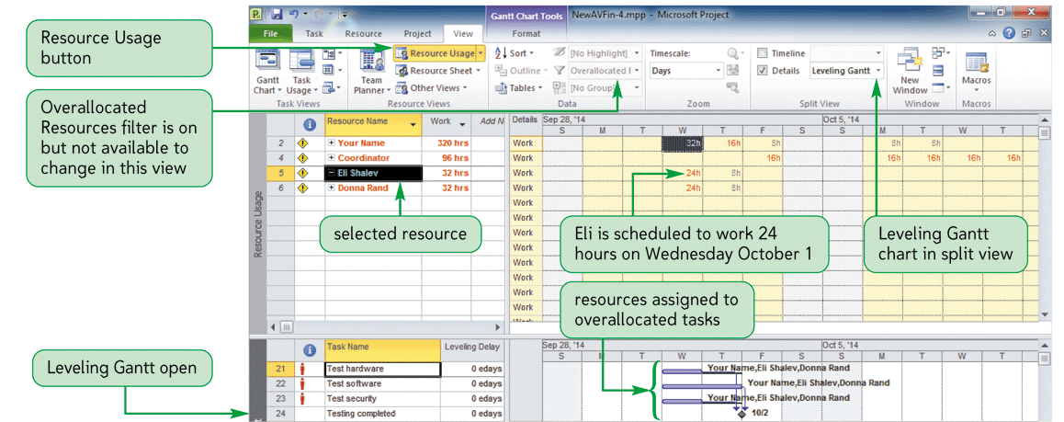
Overallocation
Source: Bunin, New Perspectives on Microsoft Project 2010
Notes:
Image Source: Bunin, New Perspectives on Microsoft Project 2010

Slide 11
Overallocation
Review the indicators showing overallocation
Familiarize ourselves with various allocation tables, views.

Slide 12
Resource Levelling
You can level a project, specific tasks, or specific resources
Manual Levelling
Levelling Tool – levels work resources by delaying or splitting tasks, can be done automatically or by manually activating this tool

Slide 13
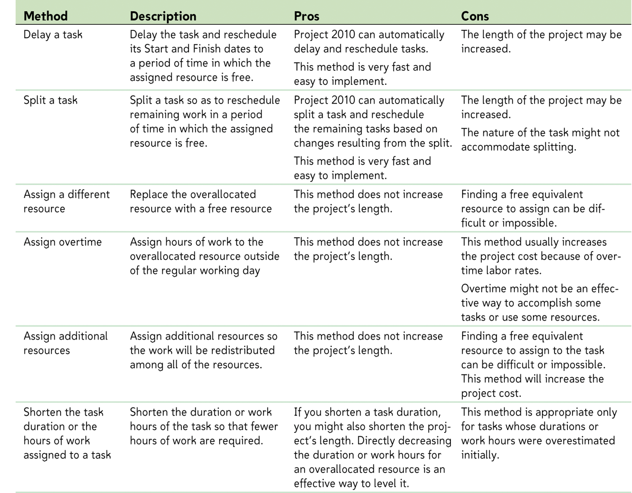
Resource Levelling
Source: Bunin, New Perspectives on Microsoft Project 2010
Notes:
Image Source: Bunin, New Perspectives on Microsoft Project 2010

Slide 14
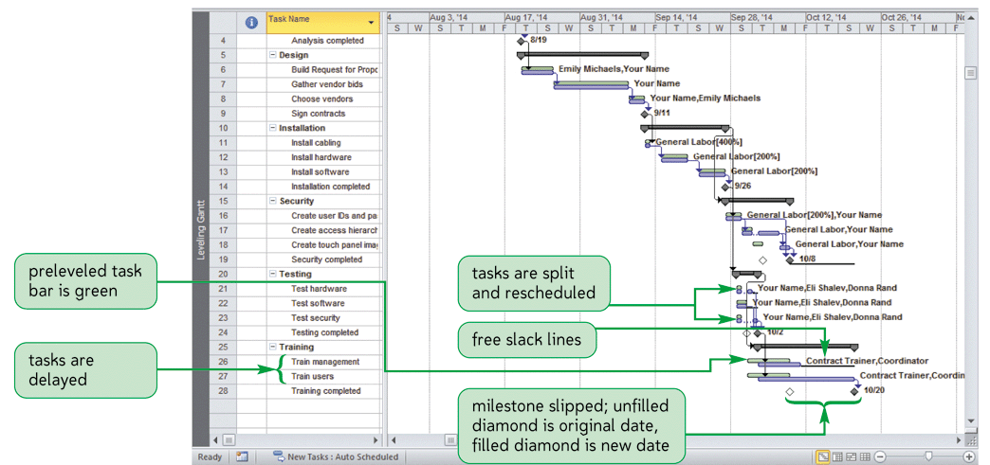
Effects of Levelling
Source: Bunin, New Perspectives on Microsoft Project 2010
Notes:
Image Source: Bunin, New Perspectives on Microsoft Project 2010

Slide 15
Shortening the Critical Path and managing Resource Utilization
Change task duration
Change task dependencies
Crashing
Fast tracking
Add negative lag time
Modify work calendar
Remove task constraints
Change the scope of your project

Slide 16
Fast Tracking
Fast Tracking is making changes to the way tasks are scheduled within your project
Parallel Scheduling – revise task dependencies on the critical path to allow for tasks to overlap shortening the critical path
Decomposing Tasks – Break down critical tasks into smaller tasks that can be worked on simultaneously by different resources

Slide 17
Crashing
Crashing is making changes to the way resources are scheduled.
Assigning additional resources – to the critical path which will decrease duration shortening your critical path
Scheduling Overtime – arrange overtime for resources with tasks on the critical path

Slide 18
Managing Overallocation
Auto leveling
Manual leveling
Crashing
Fast Tracking

Slide 19
Baselines

Slide 20
Setting the Schedule Baseline
Baseline: a record of scheduled dates and costs for each task at a particular point in time
Interim Plan: a set of Start and Finish dates that can be saved periodically
Variance cannot be calculated without a baseline

Slide 21
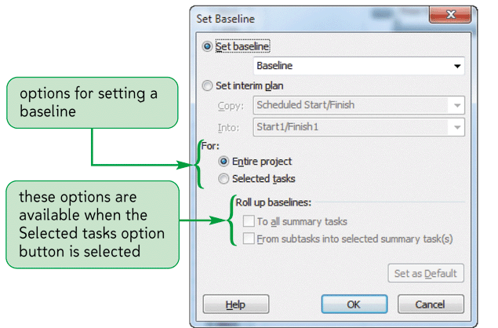
Setting the Schedule Baseline
Source: Bunin, New Perspectives on Microsoft Project 2010
Notes:
Image Source: Bunin, New Perspectives on Microsoft Project 2010

Slide 22
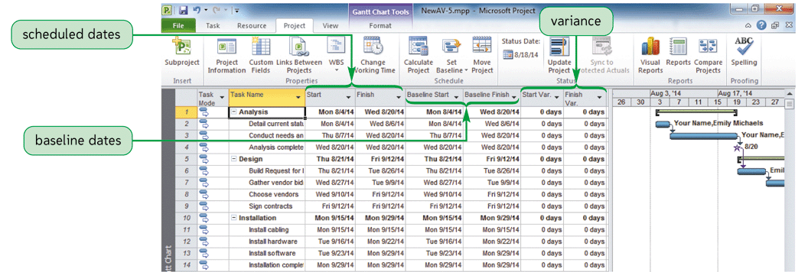
Viewing the Schedule Baseline
Source: Bunin, New Perspectives on Microsoft Project 2010
Notes:
Image Source: Bunin, New Perspectives on Microsoft Project 2010

Slide 23
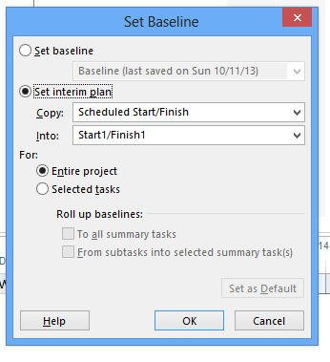
Interim Project Schedules
Interim plan A set of task start and finish dates that you can save at certain stages of your project. You can compare an interim plan with the baseline plan or current plan to monitor project progress or slippage. You can save up to 10 interim plans
Notes:
Image Source: Bunin, New Perspectives on Microsoft Project 2010

Slide 24
Baselines and Interim Schedules
Creating
Using Baselines to:
View variance
View delays
Interim Schedules

Slide 25
Practice Exercise

Slide 26
Practice Exercise E
Open the file called LandscapingE. It is located in the Content section of FOL.
Record answers so we can review.
Through Project Statistics dialogue box. (Hint: Go into Project Information, then click the Statistics… button at the bottom of the dialog box). What is the current duration for the project, in days and in work hours?
Which tasks in this project have over allocated resources?
Identify over allocated resources in various screen views/forms/charts/tables. List three of them.
Switch to the Levelling Gantt view (in the More Views option when you click along the left side of the screen).
Click the 'Leveling Options' button from the Resource menu. Select 'Level only within available slack' and clear the other over allocation techniques. Exit this dialog box. Click Level Resource from the Resource menu to resolve over allocations using this technique for the labourer resource. Make a screen snapshot of the Leveling Gantt chart. Which tasks are still over allocated?

Slide 27
Practice Exercise E – cont’d
Select the 'Leveling Options' button from the Resource menu. Select 'Level only within available slack' and clear the other overallocation techniques. Exit this dialog box. Click Level Resource from the Resource menu to resolve overallocations using this technique for the labourer resource. Paste a screen snapshot of the Leveling Gantt chart and the Project Statistics after you have levelled the labourer resource. Which tasks are still overallocated? How have the Project Statistics changed, compared to the original Project Statistics from Step 3?
Examine the Leveling Gantt chart. How are Leveling Gantt charts different from normal Gantt charts in MS Project?
Close both files. Save your Word file. You do not need to resave the new MS Project file.

Slide 28
Coming up next…

Slide 29
Activities
“Required Readings – Module 6”
Practice Exercise E
Mid Term Exam during Module 8
You will be required to use MS Project for the exam and have access to FOL during the test
You will be given a MPP project data file and will be asked questions about the project
You may NOT communicate with anyone (e.g., emailing) during the exam
Make sure your laptop battery is charged !!

Slide 30
Videos and other Supporting Material

Slide 31
Critical Path Video
http://www.youtube.com/watch?v=F1r7h15ngJw

